Slide 1
Post-quantum Public Key Cryptosystem (PKC)
Lake Bu
ASCS Lab

Slide 2
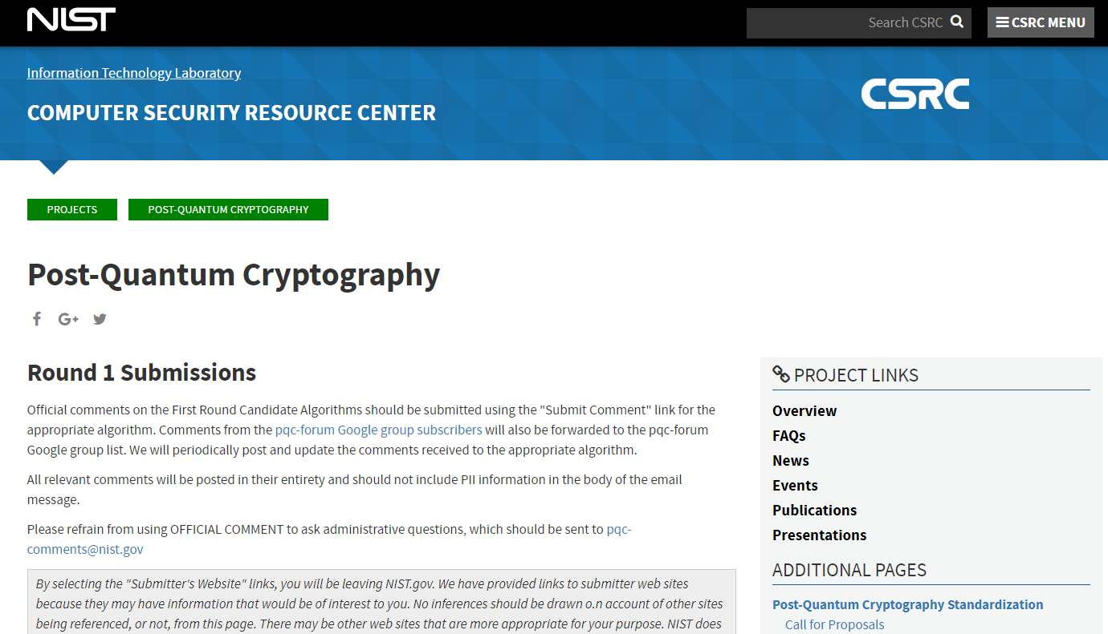
1. Post-Quantum Cryptography Standardization
[1]
[1] https://csrc.nist.gov/projects/post-quantum-cryptography/round-1-submissions

Slide 3
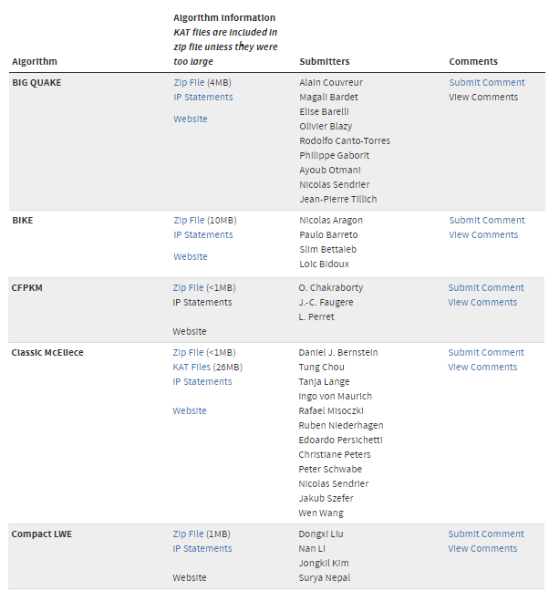
1. Post-Quantum Cryptography (PQC) Standardization
NIST
Jan 2017 - present
Evaluating 69 (5 withdrawn) submissions of PQC, to bring up a standard (just like AES):
21 lattice-based
18 code-based
Some hash-based
Some others
[1]
Submission deadline Nov 30, 2017. List updated Dec 17, 2018.
[1] https://csrc.nist.gov/projects/post-quantum-cryptography/round-1-submissions

Slide 4
1. Post-Quantum Cryptography (PQC) Standardization
Categories
Public-key Encryption
Key-exchange Mechanism
Signature System
Most Likely Contenders
Lattice-based
Code-based
Hash-based
Don't put all eggs in one basket?
[1]
Submission deadline Nov 30, 2017. List updated Dec 17, 2018.
[1] https://csrc.nist.gov/projects/post-quantum-cryptography/round-1-submissions

Slide 5
2. Why Ring-LWE?
Advantages
A branch of lattice-based cryptosystem
Able to do public-key encryption
Able to do key-exchange mechanism
Able to do digital signature
Able to build somewhat homomorphic encryption (SHE)
Used for quantum computation verification and HE[1]
Smaller key size (7k~15k bits vs. 1MB for code-based & 1TB for “post-quantum RSA”)
Simpler computation & circuits
[1] Urmila Mahadev, Classical Homomorphic Encryption for Quantum Circuits, 2018

Slide 6
2. Why Ring-LWE?
Advantages
Concerns
Only being out for 5.5 years [1] and has not withstood the test of time
The security reduction (hardness) is a modification of SVP & CVP
On the safe side, code-based cryptosystem (published in 1978, 40 years of examination) can be used
Don't put all eggs in one basket?
[1] Oded Regev et. al., On Ideal Lattices and Learning with Errors Over Rings, 06/2013

Slide 7
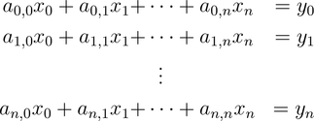
3. Ring-LWE PKC
Learning with Errors
Can be easily learnt
[1]
Very hard to learn
SVP
[1] Oded Regev, “On lattices, learning with errors, random linear codes, and cryptography”, 2005

Slide 8
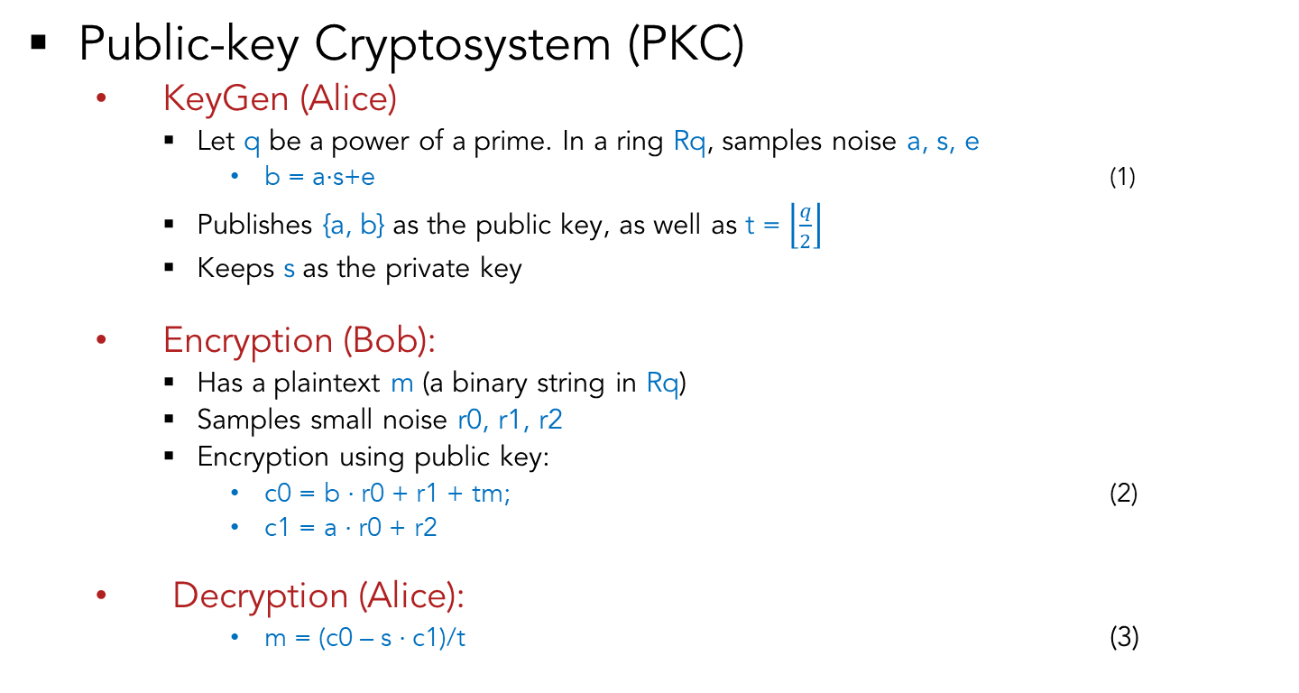

3. Ring-LWE PKC
Public-key Cryptosystem (PKC)
KeyGen (Alice)
Let q be a power of a prime. In a ring Rq, samples noise a, s, e
b = a$⋅$s+e (1)
Publishes {a, b} as the public key, as well as t = $\left\lfloor \frac{q}{2}\right\rfloor$
Keeps s as the private key
Encryption (Bob):
Has a plaintext m (a binary string in Rq)
Samples small noise r0, r1, r2
Encryption using public key:
c0 = b $⋅$r0 + r1 + tm; (2)
c1 = a $⋅$r0 + r2
Decryption (Alice):
m = (c0 – s $⋅$c1)/t (3)
$$\left\lceil 1\right.\left.111q111 \right\rfloor$$
Taking the nearest integer
[1] Oded Regev, “On lattices, learning with errors, random linear codes, and cryptography”, 2005

Slide 9
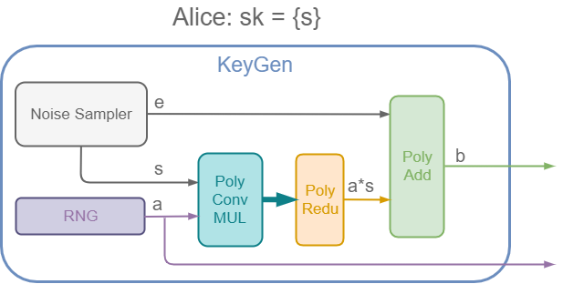

3. Ring-LWE PKC – a small implementation
Building a small model (q = 17, n = 2 vs. q = 12289, n = 512)
KeyGen (Alice)
Let q be a power of a prime. In a ring Rq, samples noise a, s, e
b = a$⋅$s+e (1)
Publishes {a, b} as the public key, as well as t = $\left\lfloor \frac{q}{2}\right\rfloor$
Keeps s as the private key

Slide 10
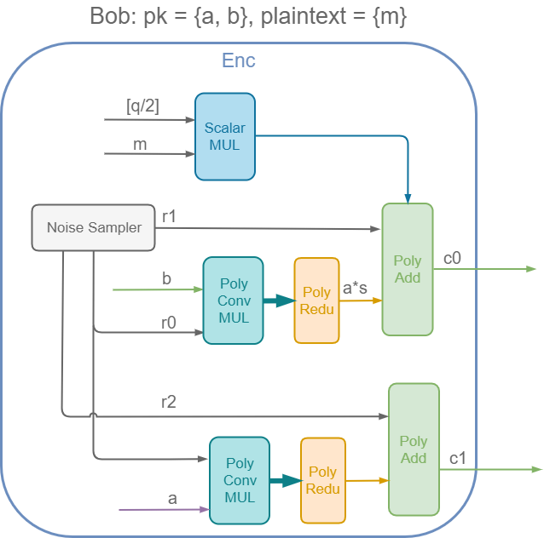

3. Ring-LWE PKC – a small implementation
Building a small model (q = 17, n = 2 vs. q = 12289, n = 512)
KeyGen (Alice)
Encryption (Bob):
Has a plaintext m (a binary string in Rq)
Samples small noise r0, r1, r2
Encryption using public key:
c0 = b $⋅$r0 + r1 + tm; (2)
c1 = a $⋅$r0 + r2

Slide 11
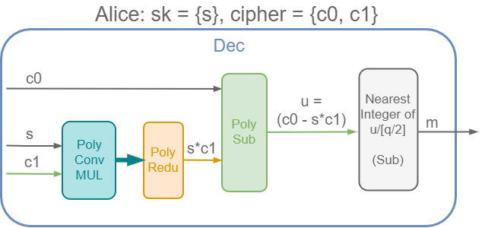
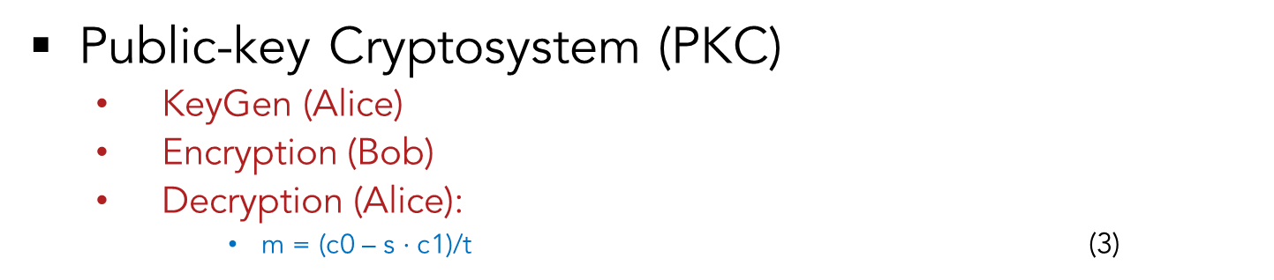

3. Ring-LWE PKC – a small implementation
Public-key Cryptosystem (PKC)
KeyGen (Alice)
Encryption (Bob)
Decryption (Alice):
m = (c0 – s $⋅$c1)/t (3)
$$\left\lceil 1\right.\left.111q11 1 \right\rfloor$$
Taking the nearest integer

Slide 12
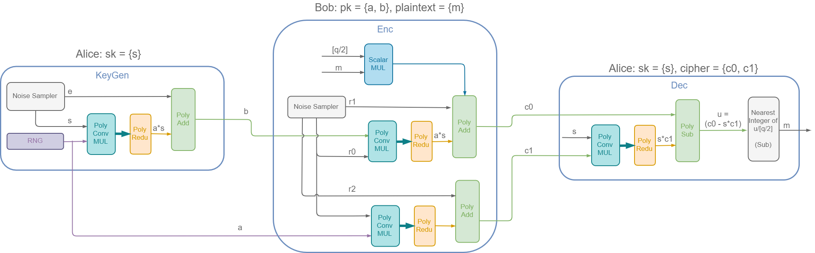
3. Ring-LWE PKC – a small implementation
Public-key Cryptosystem (PKC)
KeyGen (Alice)
Encryption (Bob)
Decryption (Alice)

Slide 13


3. Ring-LWE PKC – for real: q = 12289, n = 512
Public-key Cryptosystem (PKC)
KeyGen (Alice)
Encryption (Bob)
Decryption (Alice)
Accelerators
NWC
NNT
Fast modulo

Slide 14
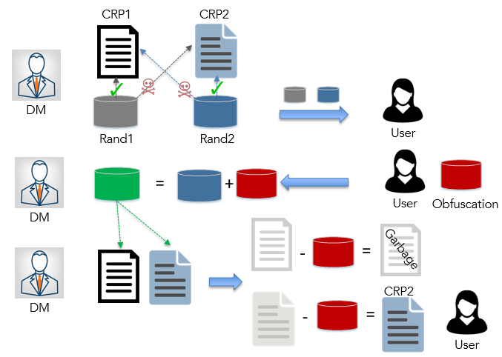
3. Ring-LWE Oblivious Transfer
Alice | Bob
m0, m1, rand0, rand1 Key pair (s, {a,b}) | c (choice) K (random)
rand0, rand1, {a,b}
 | V = rand_{c} + Enc(K, {a,b})
M0 = m0+Dec(V – rand0) M1 = m1+Dec(V – rand1)
 | M_{c} – K m_{c}

Slide 15
4. Post-Quantum Crypto Toolbox
Post-Quantum Cryptosystem Toolbox
Public-key Encryption | ✓
Key-Exchange | In progress
Oblivion Transfer | ✓
Zero-knowledge Proof | In progress
…

Slide 16

Any Questions?

